Slide 1

Enhancing Financial Inclusion Through AI
Department of Computer Science - Data Science
Authors:
Kavitha U - Associate Professor
Sreejith S - (1NH22CD127)
Manoj P - (1NH22CD064)
Poornima - (1NH22CD081)
P Harshad Ali Khan - (1NH22CD077)

Slide 2





MEET OUR TEAM
Manoj P
CSE – Data Sciences
Sreejith S
CSE – Data Sciences
Poornima
CSE – Data Sciences
P Harshad Ali Khan CSE – Data Sciences

Slide 3

Abstract
Machine learning and predictive analytics are revolutionizing financial services by enhancing credit scoring models and improving loan accessibility. This study compares five predictive models constructed using data mining approaches, focusing on an Optimized Clustering Algorithm (OCA) to reduce sample variability and increase prediction accuracy. By analyzing consumer credit datasets from Germany and Australia, our approach ensures more accurate credit evaluations, lowers financial risk, and strengthens decision-making frameworks for financial institutions.

Slide 4
INTRODUCTION
Credit scoring is a statistical approach used to assess a borrower's repayment ability. Traditional models rely heavily on credit history, but when unavailable, alternative indicators such as property ownership and family status are used. Machine learning techniques, particularly data clustering and ensemble models, enhance the predictive capabilities of credit scoring by analyzing diverse datasets. This paper explores AI-driven methodologies for financial inclusion and examines their impact on banking operations and credit accessibility.

Slide 5
Literature Survey
Credit scoring models leverage statistical techniques to classify loan applicants based on their creditworthiness.
Machine learning methods such as Support Vector Machines (SVMs), Decision Trees, and Deep Learning optimize predictive accuracy.
Fraud detection techniques in banking analyze patterns in financial transactions to distinguish between fraudulent and legitimate activities.
Cluster ensemble approaches improve classification performance by aggregating multiple clustering models.
Existing financial inclusion strategies focus on making credit accessible to small businesses and underbanked individuals.

Slide 6
OBJECTIVES
Improving Credit Scoring Accuracy: Enhancing predictive models for better decision-making.
Reducing Credit Risk: Identifying high-risk borrowers more effectively.
Expanding Loan Accessibility: Ensuring financial inclusion by offering credit to underserved populations.
Fraud Prevention: Implementing AI-driven fraud detection mechanisms.
Enhancing Efficiency: Automating credit evaluations and reducing processing times.
Optimizing Banking Operations: Utilizing AI to streamline lending procedures and compliance checks.

Slide 7
Applications in Credit Scoring and Loan Accessibility
Benefits of AI in Financial Inclusion
Enhanced Decision-Making: AI-driven insights optimize loan approval processes.
Increased Transparency: Machine learning models provide fair and unbiased credit evaluations.
Risk Mitigation: AI algorithms reduce default rates by accurately predicting loan repayment behavior.
AI for Credit Scoring
Supervised Learning: Classification models predict default probabilities based on historical data.
Unsupervised Learning: Clustering techniques categorize borrowers based on risk profiles.
Ensemble Methods: Combining multiple algorithms enhances model robustness and accuracy.
Richard Branson

Slide 8



Machine Learning in Loan Accessibility
Data Preprocessing : Handling missing values, encoding categorical data, and normalizing inputs.
Predictive Analytics : Identifying patterns in financial behavior to improve loan distribution.
Clustering Algorithms : Segmenting borrowers into risk categories for personalized credit offers.

Slide 9
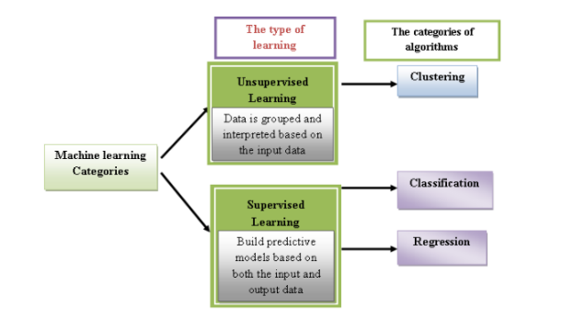
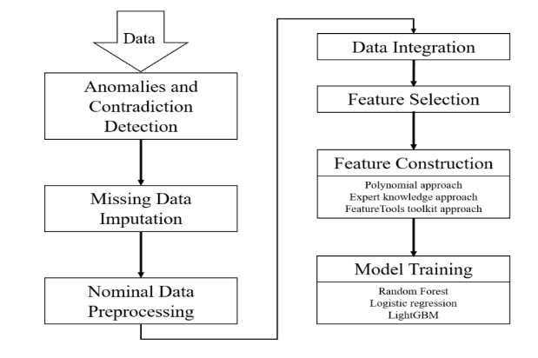
Methodology
The figure illustrates a structured pipeline for AI-driven credit scoring, encompassing data preprocessing, feature engineering, and model training.
Initially, raw data undergoes anomaly detection, missing data imputation, and nominal data preprocessing to ensure data quality.
Next, relevant features are selected, constructed using polynomial and expert-driven approaches, and integrated for improved model performance.
Finally, machine learning algorithms such as Random Forest, Logistic Regression, and Light GBM are employed to train predictive models, enhancing accuracy in credit risk assessment and financial decision-making.
FIGURE 1
FIGURE 2

Slide 10
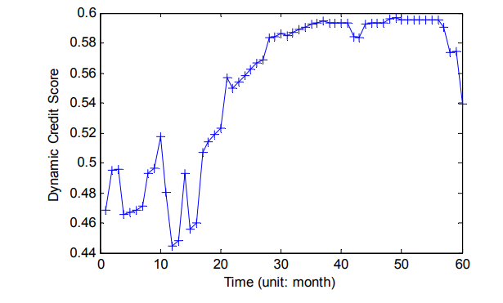
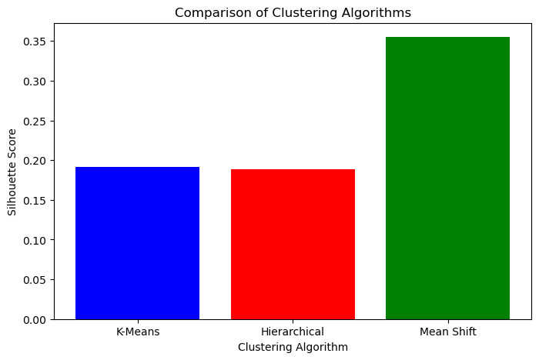
Methodology
The graph depicts the variation of dynamic credit scores over a 60-month period, showing fluctuations in financial behavior.
Initially, the credit score exhibits instability, with sharp rises and drops in the first 20 months, likely due to inconsistencies in financial activity or credit utilization.
From months 20 to 50, the score gradually stabilizes and peaks around 0.58, indicating improved creditworthiness.
However, a decline is observed towards the end of the period, suggesting potential financial distress or increased credit risk.
This trend highlights the importance of continuous monitoring and adaptive AI-driven credit assessment models for better financial decision-making.
FIGURE 3
FIGURE 4

Slide 11

SUMMARY
Transformative Impact: AI-powered credit scoring is revolutionizing financial services by increasing accessibility and reducing risk.
Banking & Finance: AI models streamline credit evaluation, making lending more efficient and transparent.
Fraud Prevention: Advanced fraud detection algorithms enhance security in financial transactions.
Future Directions: Further research will focus on refining AI models, integrating alternative data sources, and addressing regulatory challenges in AI-driven financial services.

Slide 12
THANK YOU

